Slide 1
Security Model

Slide 2
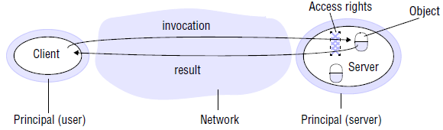
Basics of (3) Security Model
The architectural model provides the basis for security model.
The security of a distributed system can be achieved by:
Protecting the objects against unauthorized access
Securing the processes and the channels

Slide 3
Basics of (3) Security Model (cont.)
Protecting objects
Figure shows a server that manages a collection of objects on behalf of some users. The users can run client programs that send invocations to the server to perform operations on the objects. The server carries out the operation specified in each invocation and sends the result to the client.
Objects are intended to be used in different ways by different users. For example, some objects may hold a user’s private data, such as their mailbox, and other objects may hold shared data such as web pages.
To support this, access rights specify who is allowed to perform the operations of an object – for example, who is allowed to read or to write its state.

Slide 4
Basics of (3) Security Model (cont.)
We must include users in our model as the beneficiaries of access rights. We do so by associating with each invocation and each result the authority on which it is issued. Such an authority is called a principal. A principal may be a user or a process.
In our illustration, the invocation comes from a user and the result from a server.
The server is responsible for verifying the identity of the principal behind each invocation and checking that they have sufficient access rights to perform the requested operation on the particular object invoked, rejecting those that do not.
The client may check the identity of the principal behind the server to ensure that the result comes from the required server.

Slide 5
Basics of (3) Security Model (cont.)
2. Securing processes and their interaction
Processes interact by sending messages.
The messages are exposed to attack because the network and the communication service that they use are open, to enable any pair of processes to interact.
Servers and peer processes expose their interfaces, enabling invocations to be sent to them by any other process.
Distributed systems are often deployed and used in tasks that are likely to be subject to external attacks by hostile users. This is especially true for applications that handle financial transactions, confidential or classified information or any other information whose secrecy or integrity is crucial.

Slide 6
Basics of (3) Security Model (cont.)
Integrity is threatened by security violations as well as communication failures. So we know that there are likely to be threats to the processes of which such applications are composed and to the messages travelling between the processes.
But how can we analyze these threats in order to identify and defeat them? The further discussion introduces a model for the analysis of security threats.

Slide 7
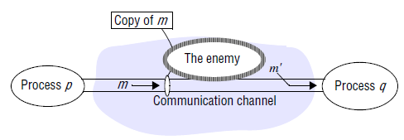
Security Model- The Enemy
To model security threats, we postulate an enemy (sometimes also known as the adversary) that is capable of sending any message to any process and reading or copying any message sent between a pair of processes, as shown in Figure.

Slide 8
Security Model- The Enemy (cont.)
Such attacks can be made simply by using a computer connected to a network to run a program that reads network messages addressed to other computers on the network, or a program that generates messages that make false requests to services, purporting to come from authorized users.
The attack may come from a computer that is legitimately connected to the network or from one that is connected in an unauthorized manner.
The threats from a potential enemy include threats to processes and threats to communication channels.

Slide 9
Threats to Processes
A process that is designed to handle incoming requests may receive a message from any other process in the distributed system, and it cannot necessarily determine the identity of the sender.
Communication protocols such as IP do include the address of the source computer in each message, but it is not difficult for an enemy to generate a message with a forged source address.
This lack of reliable knowledge of the source of a message is a threat to the correct functioning of both servers and clients, as explained further:

Slide 10
Threats to Processes (cont.)
Servers:
Since a server can receive invocations from many different clients, it cannot necessarily determine the identity of the principal behind any particular invocation.
Even if a server requires the inclusion of the principal’s identity in each invocation, an enemy might generate an invocation with a false identity. Without reliable knowledge of the sender’s identity, a server cannot tell whether to perform the operation or to reject it.
For example, a mail server would not know whether the user behind an invocation that requests a mail item from a particular mailbox is allowed to do so or whether it was a request from an enemy.

Slide 11
Threats to Processes (cont.)
Clients:
When a client receives the result of an invocation from a server, it cannot necessarily tell whether the source of the result message is from the intended server or from an enemy, perhaps ‘spoofing’ the mail server.
Thus, the client could receive a result that was unrelated to the original invocation, such as a false mail item (one that is not in the user’s mailbox).

Slide 12
Threats to Communication Channels
An enemy can copy, alter or inject messages as they travel across the network and its intervening gateways. Such attacks present a threat to the privacy and integrity of information as it travels over the network and to the integrity of the system. For example, a result message containing a user’s mail item might be revealed to another user or it might be altered to say something quite different.
Another form of attack is the attempt to save copies of messages and to replay them at a later time, making it possible to reuse the same message over and over again.
For example, someone could benefit by resending an invocation message requesting a transfer of a sum of money from one bank account to another.
All these threats can be defeated by the use of secure channels, which are described below and are based on cryptography and authentication.

Slide 13
Defeating Security Threats
Here we will introduce the main techniques on which secure systems are based.
Cryptography and shared secrets:
Suppose that a pair of processes (for example, a particular client and a particular server) share a secret; that is, they both know the secret but no other process in the distributed system knows it.
Then if a message exchanged by that pair of processes includes information that proves the sender’s knowledge of the shared secret, the recipient knows for sure that the sender was the other process in the pair.
Of course, care must be taken to ensure that the shared secret is not revealed to an enemy.

Slide 14
1. Cryptography and shared secrets (cont.)
Cryptography is the science of keeping messages secure, and encryption is the process of scrambling a message in such a way as to hide its contents.
Modern cryptography is based on encryption algorithms that use secret keys – large numbers that are difficult to guess – to transform data in a manner that can only be reversed with knowledge of the corresponding decryption key.

Slide 15
2. Authentication
The use of shared secrets and encryption provides the basis for the authentication of messages – proving the identities supplied by their senders.
The basic authentication technique is to include in a message an encrypted portion that contains enough of the contents of the message to guarantee its authenticity.
The authentication portion of a request to a file server to read part of a file, for example, might include a representation of the requesting principal’s identity, the identity of the file and the date and time of the request, all encrypted with a secret key shared between the file server and the requesting process.
The server would decrypt this and check that it corresponds to the unencrypted details specified in the request.

Slide 16
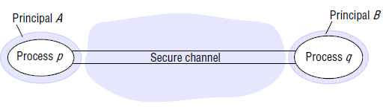
3. Secure Channels
Encryption and authentication are used to build secure channels as service layers on the top of the existing communication services.
A secure channel is a communication channel connecting a pair of processes, each of which acts on behalf of a principal, as shown in Figure.

Slide 17
3. Secure Channels (cont.)
A secure channel has the following properties:
Each of the processes knows reliably the identity of the principal on whose behalf the other process is executing. Therefore if a client and server communicate via a secure channel, the server knows the identity of the principal behind the invocations and can check their access rights before performing an operation. This enables the server to protect its objects correctly and allows the client to be sure that it is receiving results from a bona fide server.
A secure channel ensures the privacy and integrity (protection against tampering) of the data transmitted across it.
Each message includes a physical or logical timestamp to prevent messages from being replayed or reordered.

Slide 18
4. Other Possible Threats
Denial of service:
This is a form of attack in which the enemy interferes with the activities of authorized users by making excessive and pointless invocations on services or message transmissions in a network, resulting in overloading of physical resources (network bandwidth, server processing capacity).
Such attacks are usually made with the intention of delaying or preventing actions by other users.
For example, the operation of electronic door locks in a building might be disabled by an attack that saturates the computer controlling the electronic locks with invalid requests.

Slide 19
4. Other Possible Threats (cont.)
Mobile code:
Mobile code raises new and interesting security problems for any process that receives and executes program code from elsewhere, such as the email attachment.
Such code may easily play a Trojan horse role, purporting to fulfil an innocent purpose but in fact including code that accesses or modifies resources that are legitimately available to the host process but not to the originator of the code.
The methods by which such attacks might be carried out are many and varied, and the host environment must be very carefully constructed in order to avoid them. Many of these issues have been addressed in Java and other mobile code systems.

Slide 20
The Uses of Security Models
It might be thought that the achievement of security in DS would be a straightforward matter involving the control of access to objects according to predefined access rights and the use of secure channels for communication. Unfortunately, this is not generally the case.
The use of security techniques such as encryption and access control incurs substantial processing and management costs.
The security model outlined above provides the basis for the analysis and design of secure systems in which these costs are kept to a minimum, but threats to a distributed system arise at many points, and a careful analysis of the threats that might arise from all possible sources in the system’s network environment, physical environment and human environment is needed. This analysis involves the construction of a threat model listing all the forms of attack to which the system is exposed and an evaluation of the risks and consequences of each.
The effectiveness and the cost of the security techniques needed can then be balanced against the threats.

